Slide 2
Open Service Broker for Azure
Sam Cogan
Solution Architect, Willis Towers Watson & Azure MVP

Slide 3

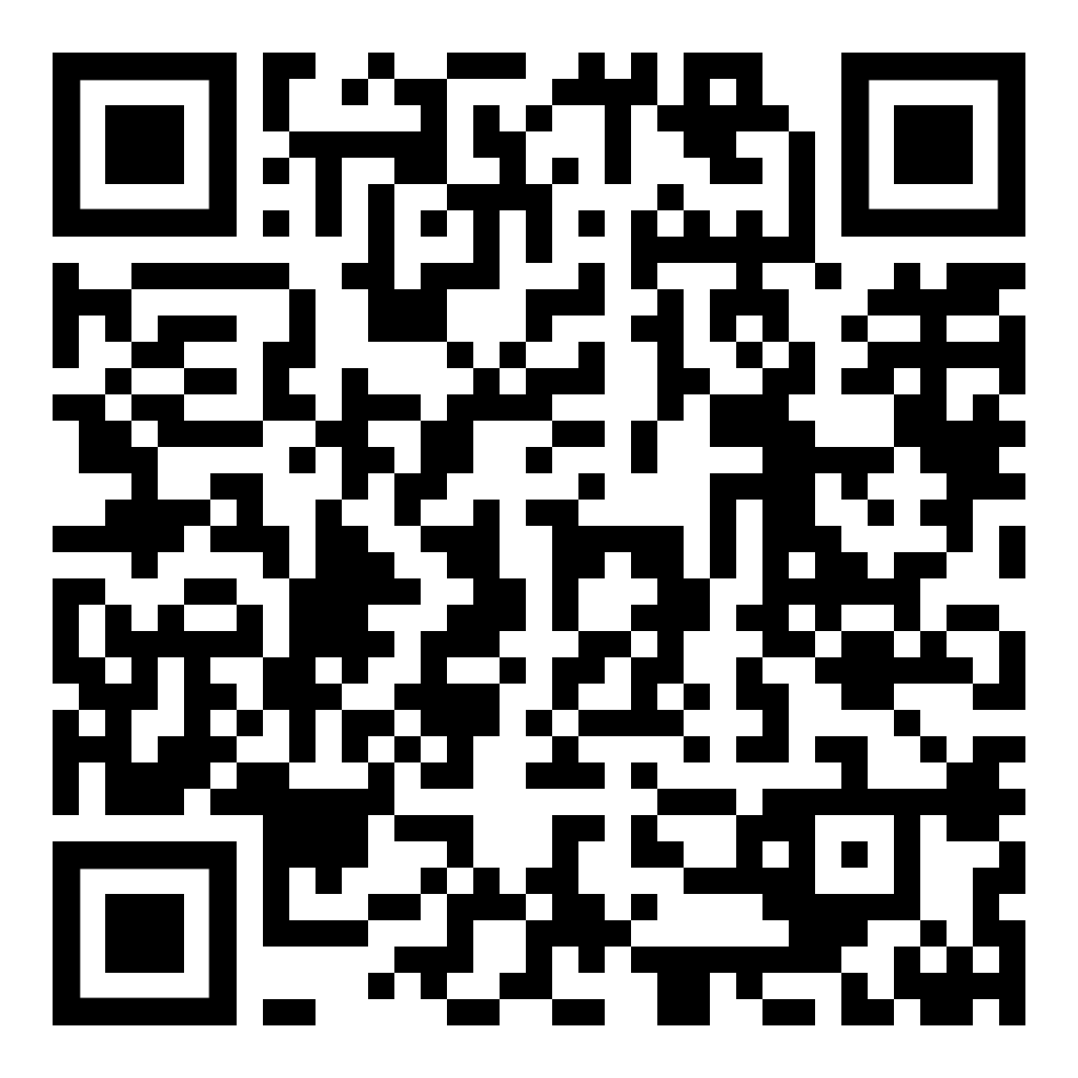



About Me
Sam Cogan
Solution Architect – Willis Towers Watson
Microsoft Azure MVP
samcogan.com
@samcogan
sam-cogan

Slide 4

Open Service Broker
“Deliver and Manage Services to Applications Running in a Cloud Native Environment”

Slide 5




Open Service Broker
Provide a Catalog of Services
Provision New Instances
Connect and Disconnect Applications
Deprovisioning Instances

Slide 6
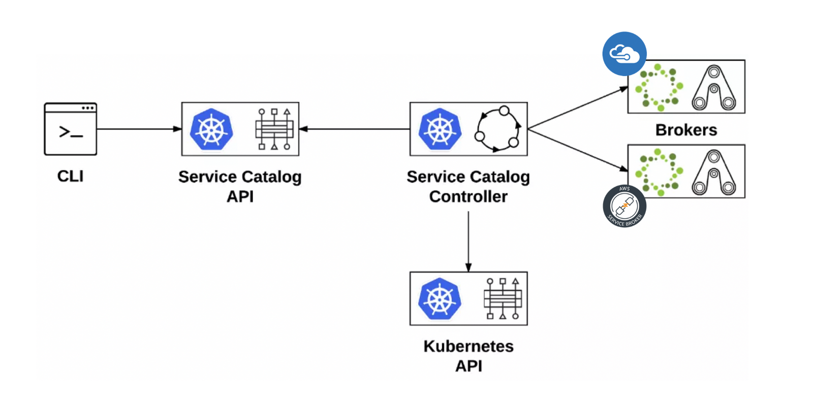
Open Service Broker

Slide 7
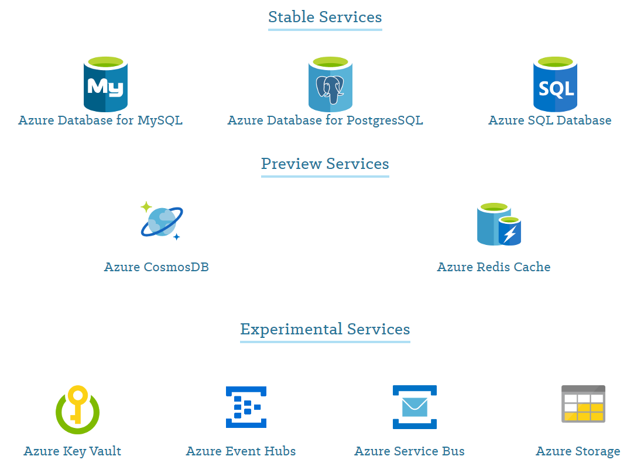
Open Service Broker for Azure

Slide 8
Demo

Slide 9
Get Started
Open Service Broker - https://www.openservicebrokerapi.org/
Open Service Broker for Azure - https://osba.sh/
OSBA Github - https://github.com/Azure/open-service-broker-azure

Slide 10
About Me
Sam Cogan
Solution Architect – Willis Towers Watson
Microsoft Azure MVP
samcogan.com
@samcogan
sam-cogan

